Slide 1
Hardware, Networking &CCNA

Slide 2
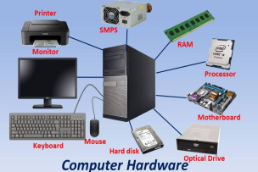
HARDWARE
Hardware is the physical components of a computer or electronic device, like the keyboard, monitor, and motherboard.

Slide 3
Components of Hardware
MOTHER BOARD
PROCESSOR
HEAT SINK
COOLER
RAM
SMPS
HARD DISK
POWER CABLES
GRAPHICS CARD
UPS
MOUSE
KEYBOARD
MONITOR

Slide 4
Hardware Components are further divided into three groups.
1. Input Devices
2. Output Devices
3. System Unit

Slide 5
INPUT DEVICE
An input device lets you communicate with a computer. You can use input devices to enter information and issue commands.
OUTPUT DEVICE
An output device displays information on a screen, creates printed copies or generates sound.
SYSTEM UNIT
The system unit is the part of the computer which is responsible for accepting anf processing the data brought in by the input devices

Slide 6
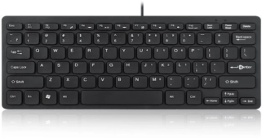
INPUT DEVICES
Keyboard
Is a standard input device of most computer. Used to type data into the computer.

Slide 7
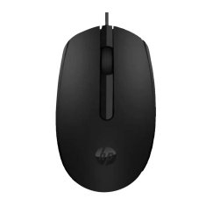
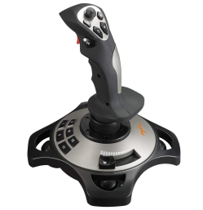
MOUSE
Is a hand-clicked device used for pointing and moving objects.
JOYSTICK
Is an input device which is commonly used for computer games

Slide 8
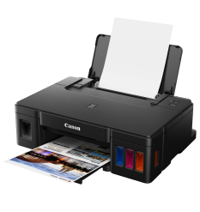
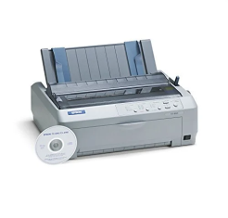
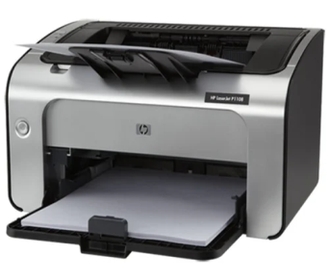
OUTPUT DEVICES
PRINTERS
An output device that produces text and graphics on paper.
INKJET Printer, LASER Printer, IMPACT Printer

Slide 9
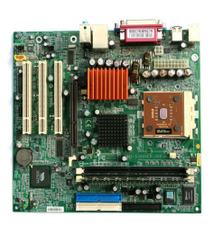
SYSTEM UNIT
Motherboard
The motherboard is the main circuit board of a microcomputer. It is also known as the mainboard or system board

Slide 10
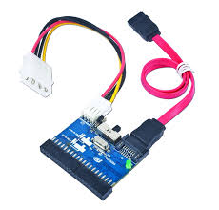
IDE SATA
Serial advances technology attachment

Slide 11
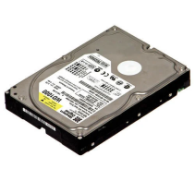
Hard-Disk Drive
Is a storage device that store billions of character of data on a nonremovable disk

Slide 12
NETWORK

Slide 13
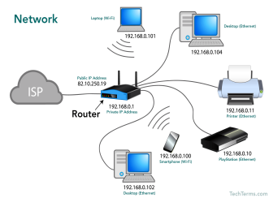
NETWORK
A group of two or more computers or other electronic devices that are interconnected for the purpose of exchanging data and sharing resources.

Slide 14
NETWORK TOPOLOGIES
Network topologies refer to the layout or structure of interconnected devices in a network.
1. Star Topology: All devices connect to a central hub or switch.
2. Bus Topology: Devices connect to a single backbone cable.
3. Ring Topology: Devices connect in a closed loop.
4. Mesh Topology: Devices connect directly to each other.
5. Hybrid Topology: Combination of two or more topologies.

Slide 15
OSI Layer
OSI (Open System Interconnect Reference Model)
OSI was developed by the international Organization for Standardization(ISO) and introduced in 1984.
It is a layered architecture (consists of seven layers).
Each layer defines a set of functions which takes part in data communication.

Slide 16
OSI MODEL LAYERS
User support Layers
or
Software Layers
Layer – 7 Application
Layer – 6 Presentation
Layer – 5 Session
Layer – 4 Transport
Layer – 3 Network
Layer – 2 Data Link
Layer – 1 Physical
Core layer of the OSI
Network support Layers
or
Hardware Layers

Slide 17
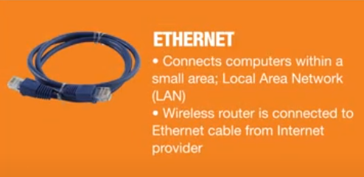
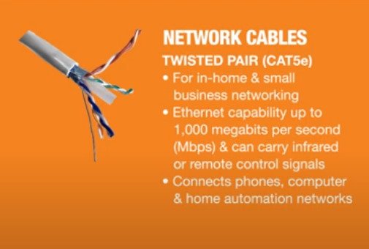
Network Cable and connectors
TYPES OF CABLE

Slide 18
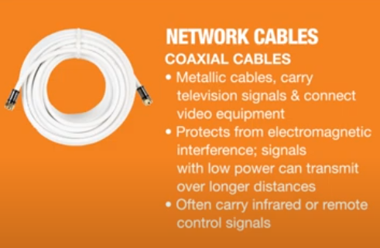
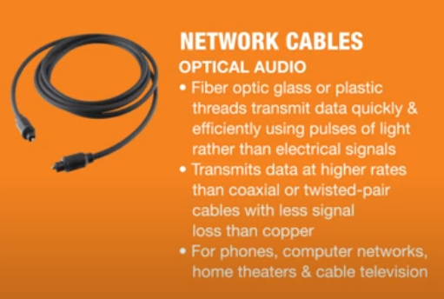

Slide 19
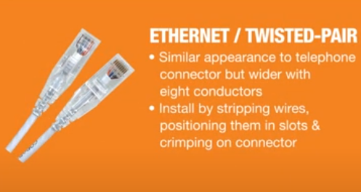
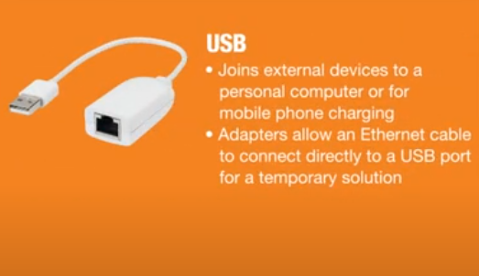
TYPES OF CONNECTORS

Slide 20
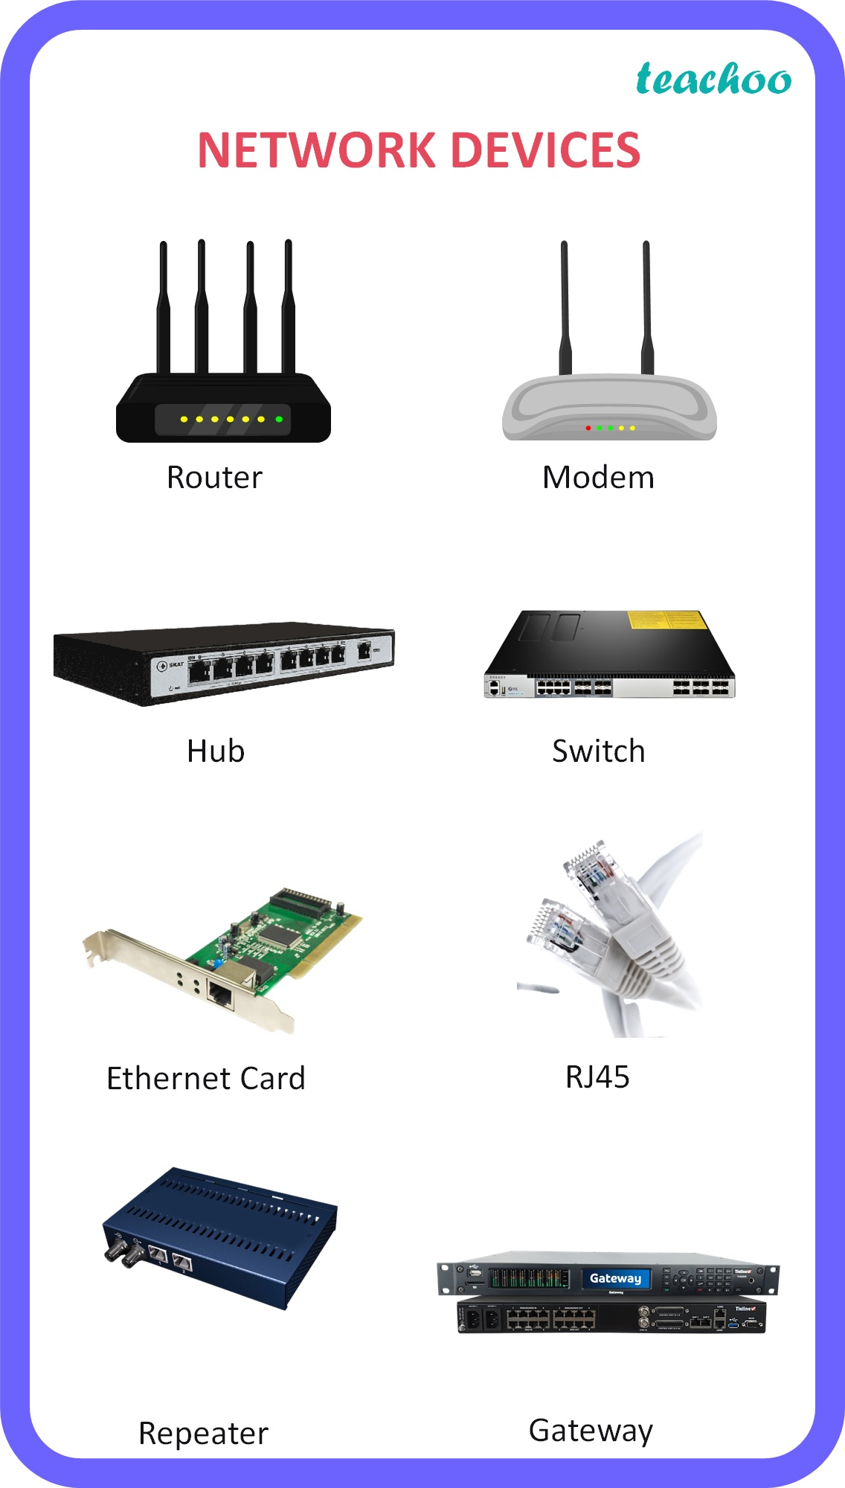
Network devices

Slide 21
IP Address
IP addressing assigns unique numerical identifiers to device on a network, enabling them to communicate with each other.
IP address is logical address
Two version of IP:
IP version 4 is a 32 bit address
IP version 6 is a 128 bit address

Slide 22
IP version 4
Bit is represent by 0 or 1 (i.e. Binary)
IP address in binary form (32 bit):
01010101000001011011111100000001
32 bit are divided into 4 Octets
First octet Second Octet Third Octet Forth Octet
01010101 00000101 10111111 00000001
IP address in decimal form:
85.5.191.1

Slide 23
IP version 6
It is represented in hex notation
FEDC:BA98:7654:3210:FEDC:BA98:7654:3210
Format of IPv6 Address:
X:X:X:X:X:X:X:X:X where X is 16 bits
(4 hex digits)
Not case sensitive for A,B,C,D,E,F
Leading zeros in a field are optional.
Successive Fields of 0 can be represented as “::” but only once.

Slide 24
IP Address Classification
IP address are divided into 5 classes
Class A
Class B Used in LAN & WAN
Class C
Class D Reserved For Multicasting
Class E Reserved for Research & Development

Slide 25
Classification of area by their geography
NETWORK
PAN LAN WAN MAN CAN
PAN – Personal Area Network is a computer network Organization around an individual person.
LAN – Local Area Network is a network which is designed to operate over a small physical area such as an office, factory or a group of buildings.

Slide 26
WAN – Wide-Area Network is the technology that connects your offices, data centers, Cloud application, and cloud storage together.
MAN - Metropolitan area network is a computer network that connects computer within a metropolitan area which could be a single large city, multiple cities and towns, or any given large area with multiple buildings.
It is in between LAN & WAN technology that covers the entire city.
CAN – The Campus Area Network is made up of am interconnection of LAN with limited Geographical area.

Slide 27
CCNA Cisco Certified Network Associate

Slide 28
CCNA
This certification builds a foundation in and apprentice knowledge of networking.
CCNA certified professional can install, configure, and operate LAN, WAN and access services for small network (100 modes or fewer), including but not limited to use of these protocols: IP, IGRP, SERIAL FRAME-RELAY, IP RIP, VLANs, RIP ETHERNET, ACCESS-LISTS.

Slide 29
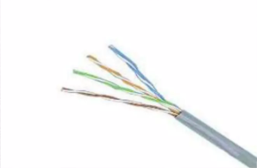
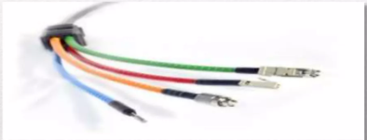
NETWORK
A network is a system that transmits any combination of voice, video or data between users.

Slide 30
TYPES OF NETWORK
Based on GEOGRAPHICAL
LAN (Local Area Network)
MAN (Metropolitan Area Network)
WAN (Wide Area Network)
PAN (Personal Area Network)

Slide 31
NETWORKING DEVICES
Router
Routers are used to connect Network together
Router packets of data from one network to another
DTE dev
HUB
Connects a group of hosts
Work on fix bandwidth
Switch
Switch add more intelligence to data transfer management
Manageable device

